Slide 1
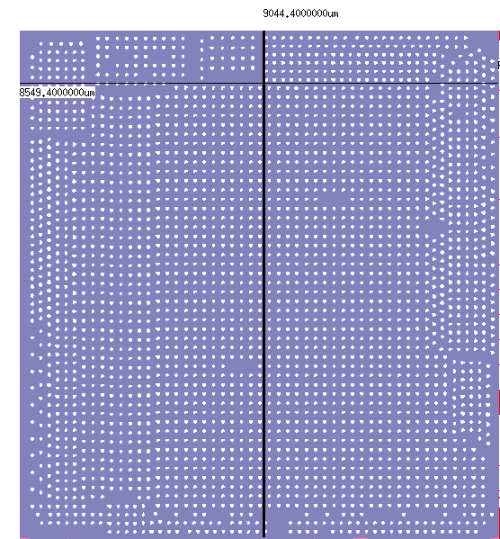
SHICC N28 LF TMJX23 bump information
TMJX23 layout
  Die size: 9.044 * 8.549 mm²

Slide 2

SHICC N28 LF TMJX23 bump information
Bump scheme
  Bump height: 75 um
  UBM width: 80 um
Bump material
Bump: Sn/Ag
Ni
UBM: Ti/Cu

